Slide 1

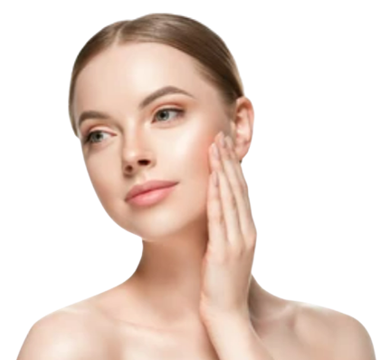

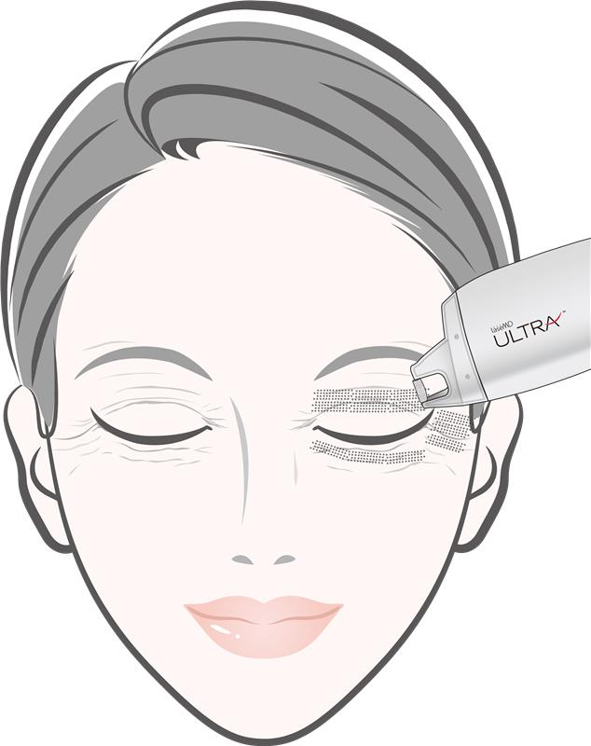
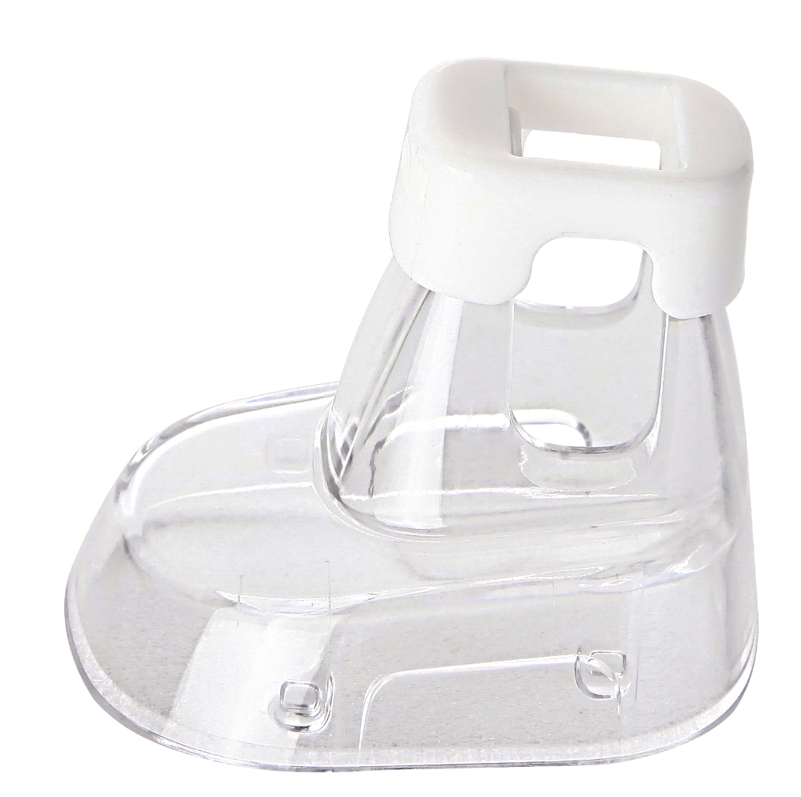
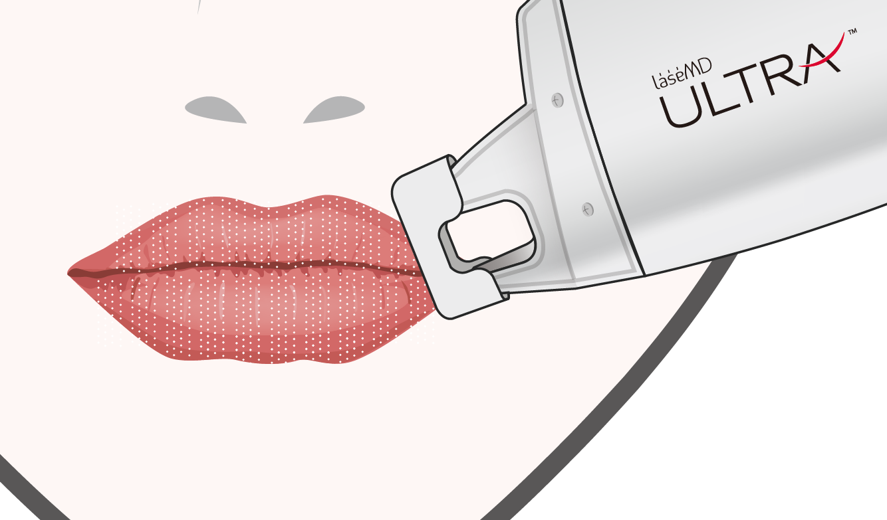
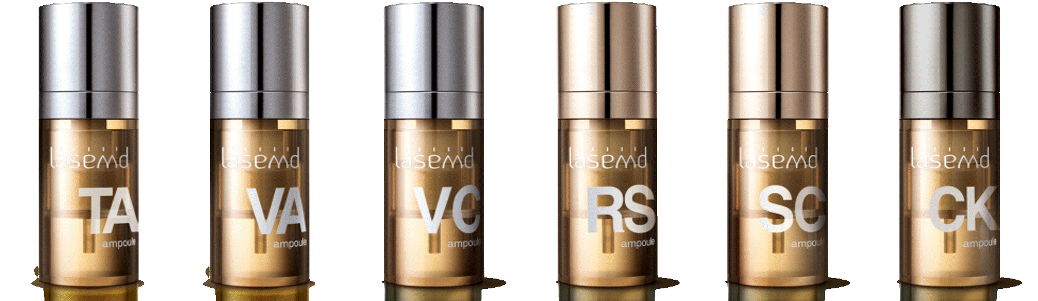
Treatment Guidelines
<Skin Rejuvenation>
[Full face] UltraGlow Therapy
[Eyelid] Eyelid Rejuvenation
ULTRA Perfect
1-DAY Combination
[Nasal & T zone] Enlarged Pores / Active Acne
[Lip] Lip rejuvenation
[Hand]
[Neck]
Off-Face Rejuvenation
[Décolleté]
UltraGlow Therapy
Indications | Skin Type | Tip Type | Energy (mJ) | Mode | Passes | Coverage % | Total Energy(kJ) | Session | Interval (week)
Uneven skin tone Skin roughness Fine wrinkles (30 ~ 50 yrs) | I-III | C1 Roller | 10 ~ 15 | Random | 4 ~ 6 | 12 - 25 | 0.2 ~ 0.5 | 3 ~ 5 | 3 ~ 4
 | III-VI |  | 8 ~ 10 |  | 2 ~ 4 | 5 ~ 12
 | UltraGlow Therapy is a basic rejuvenation technique that improves the overall skin tone, texture and fine wrinkles together for a total skin glow. For all facial area treatments, follow UltraGlow therapy parameters for full face first, and then target focal indications listed below. The Total Energy per session could be adjusted according to the skin age or skin condition: * 20~30 yrs – 0.2~0.3 kJ Total Energy for full face; 40~60 yrs – 0.4~0.5 kJ Total Energy for full face;
[FULL FACE]
[Focused]
Indications | Skin Type | Tip Type | Energy (mJ) | Mode | Passes | Coverage % | Session | Interval (week)
Periorbital wrinkle (Eyelid : Upper, Lower) | I-II | C1 Roller | 8 ~ 12 | Static Random | 2 ~ 4 | 8 ~ 15 | 3 ~ 5 | 3 ~ 4
 | III-VI |  | 5 ~ 8 |  |  | 5 ~ 8
 | Treat the area while gently applying tension to the skin above/below the eye as much as possible. Recommend 1 ~ 2 less passes on the upper eyelid than the lower. Use of contact-type eye shields is recommended.
or
Dark and dull lip color Rough and wrinkled lips | I-VI | C5 | 3 ~ 5 | Static | 3 ~ 4 | 15 ~ 22 | 3 ~ 6 | 3 ~ 4
 | Placing wet gauze between teeth and lips before treatment is recommended to protect teeth. Apply anesthetic cream for 5-10 min. End point: Mild frosting and edema Post care: Apply lip protection until microcrusts fall off Note : Minimize irritation to the lips.(Spicy and hot food, makeup etc.)
C5 Tip
Off face photoaging (Neck, décolleté, hands etc) | I-II | C1 Roller | 10 ~ 15 | Random | 4 | 12 ~ 18 | 3 ~ 5 | 3 ~ 4
 | III-VI |  | 5 ~ 10 |  | 4 | 5 ~ 12
 | Treat the body area quickly with the roller tip and in random mode. Adjust the energy taking the skin thickness of the target area into consideration.
▪ End point: Mild to Moderate erythema and edema ▪ Post care: Moisturize the skin and apply cooling
▪ Note
► Apply anesthetic cream for 30 - 40 min.
► Microcrusts will form after the treatment and will naturally fall off within 3 - 7 days.
► Post-treatment, select and apply an effective ampoule is recommended according to the patient's skin condition.
1

Slide 2
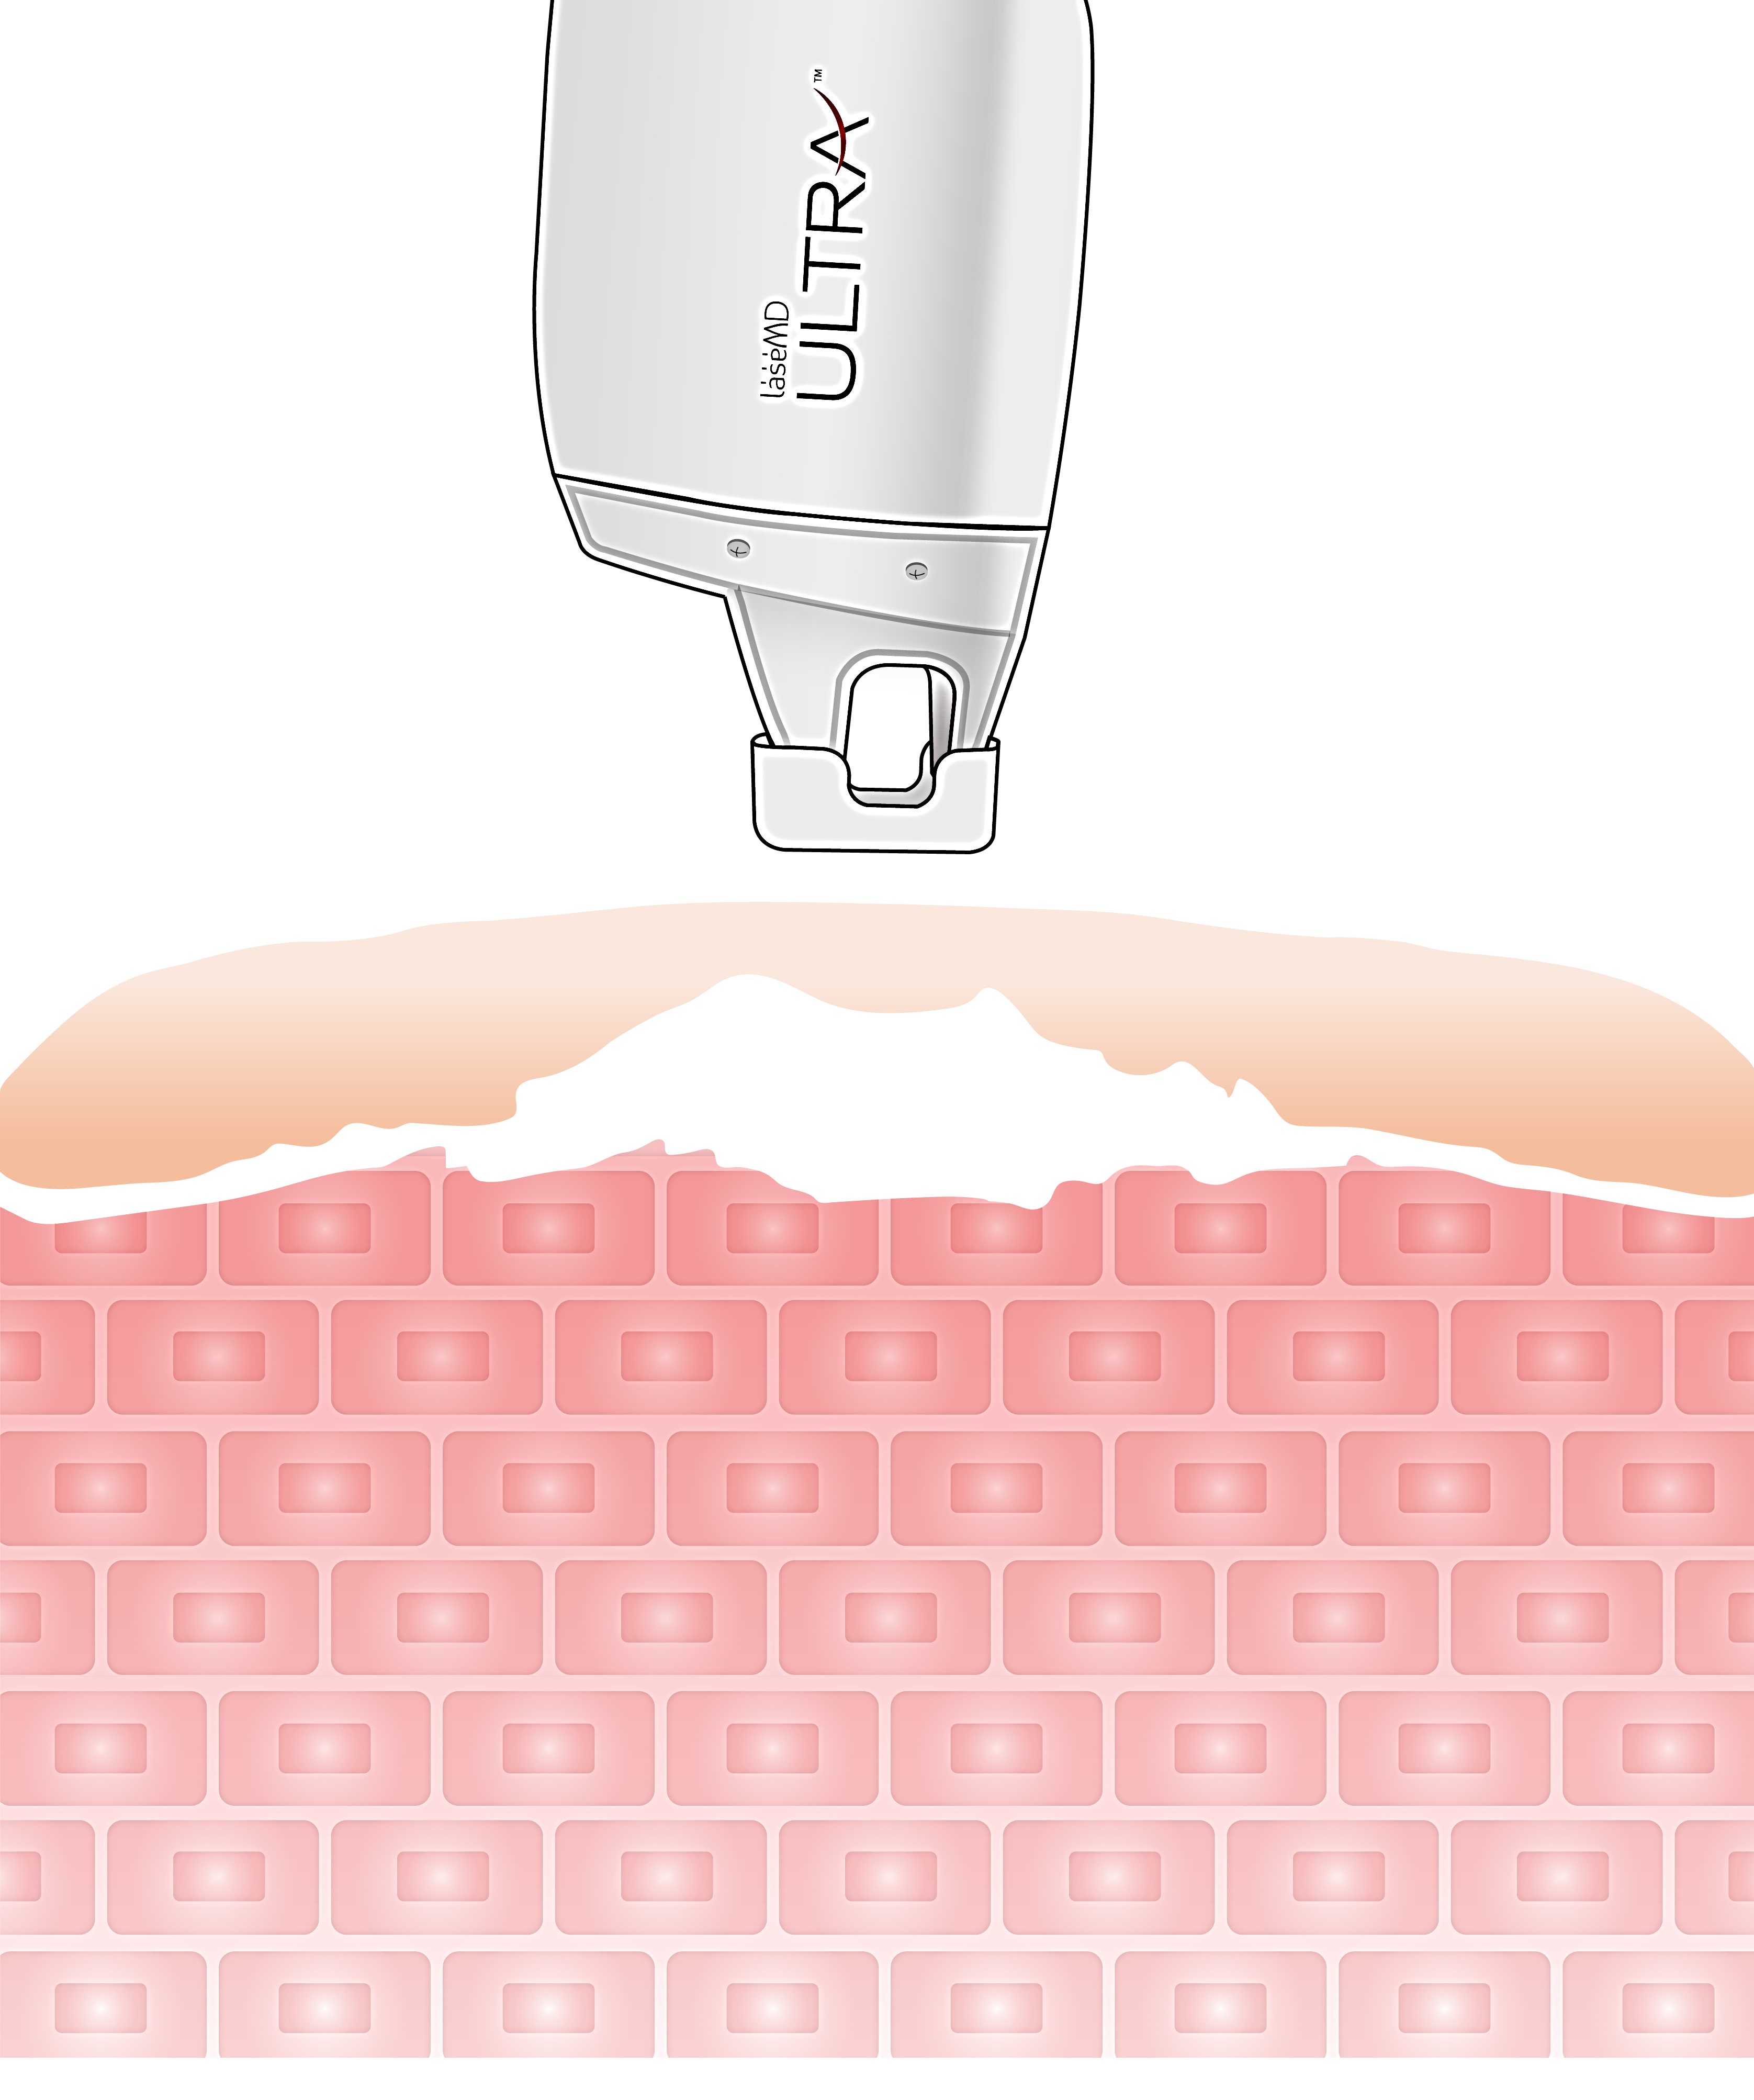
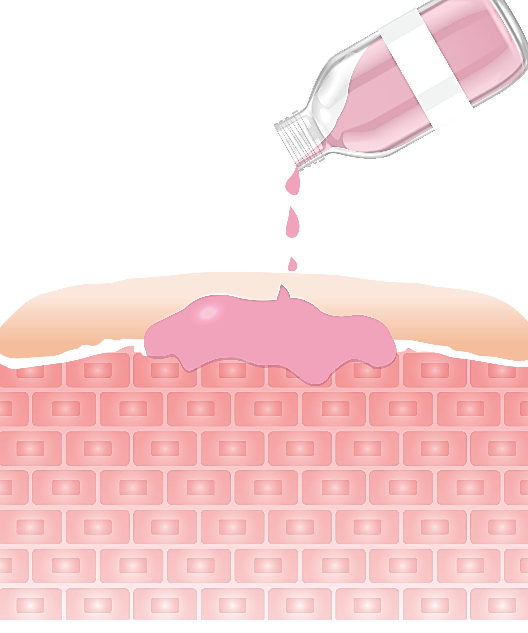
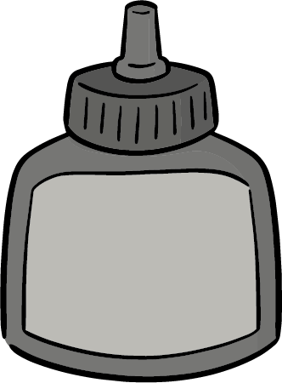
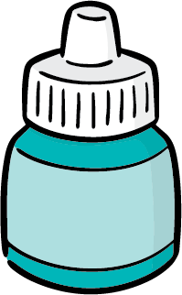

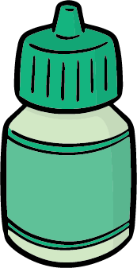
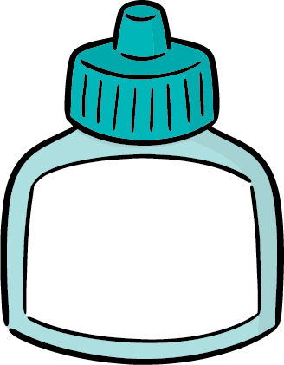

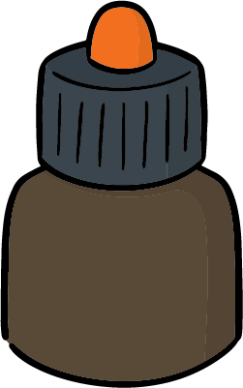
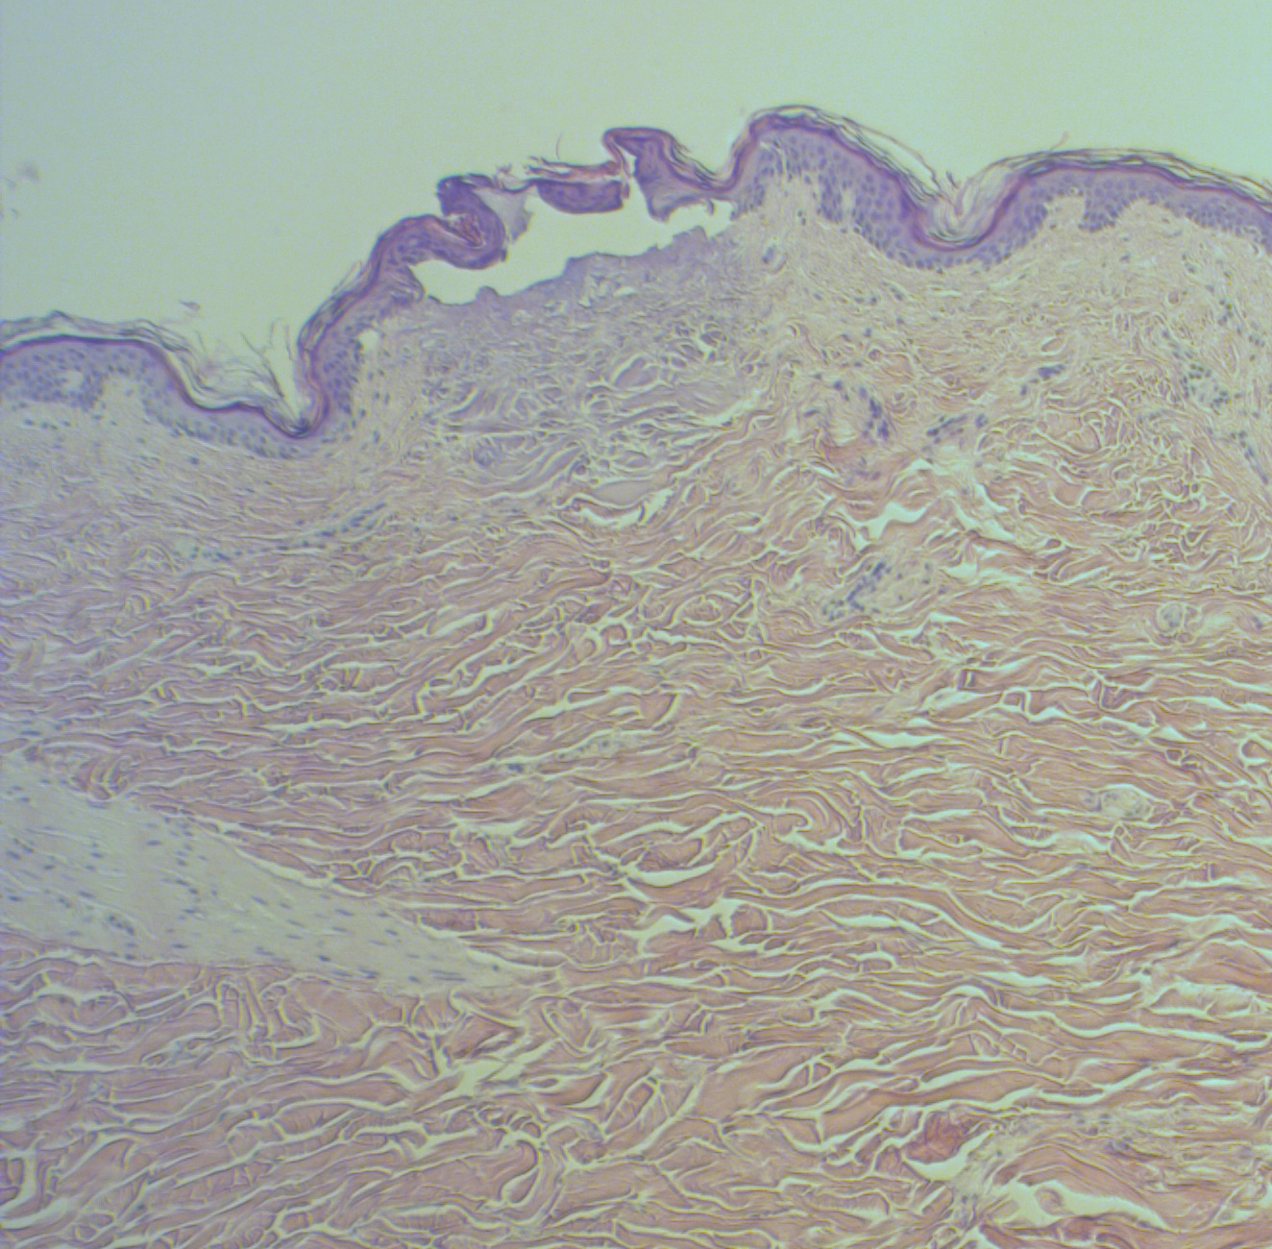
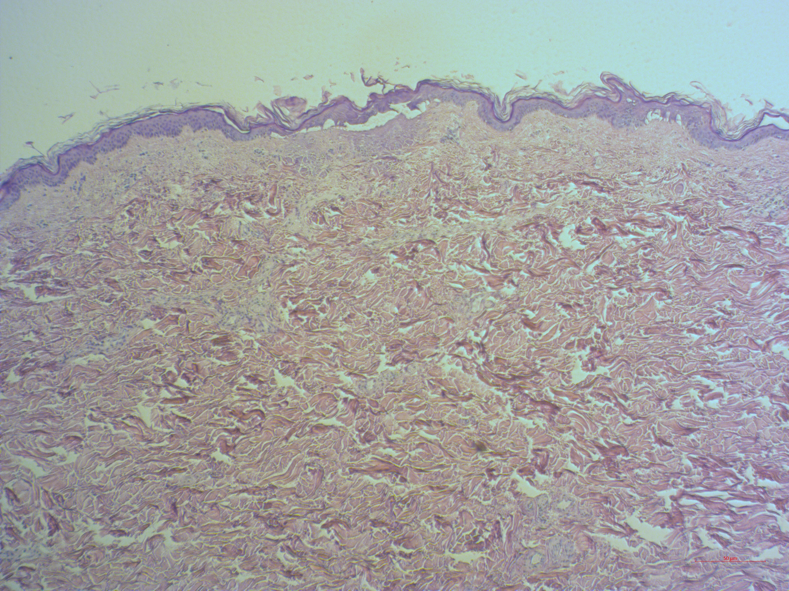

Treatment Guidelines
Topical Delivery System
Treatment Steps
Skin booster
LaseMD Ampoules
e.g.)
A
B
C
D
①
Topical solution
E
F
G
C5 Tip
②
Step 1. [ULTRA] Treat all over the face with the C5 tip.
** The handpiece tip should be in contact with the skin.
Step 2. [Topical solution] Place the selected topical solution in the syringe or container and apply evenly across the skin.
Advantages
ULTRA + Topical Solution
Better Efficacy
Large microbeam size (C5 tip), higher coverage %
The topical solution is evenly absorbed at the same depth in the skin.
Short Downtime & Less Pain
C1 Roller
C5
Epidermis intact => Short recovery period
No bruising, no swelling and no signs of laser impacts
C5 Tip
Fast treatment
Large scan area (C5 tip)
No topical anesthesia required.
C5 Tip
Thulium Peeling
Indications | Skin Type | Tip Type | Energy (mJ) | Mode Density | Passes | Coverage % | Total Energy(kJ) | Session | Interval (week)
Uneven Skin tone & Skin Texture Prejuvenation (≥20 yrs) | I-VI | C5 | 1 ~ 3 | Static 225 spots/cm2 | 1 ~ 2 50% Overlap | 8 ~ 10 | 0.1 ~ 0.2 | 3 ~ 5 | 2
 | Thulium Peeling is a comfortable treatment which can prevent and improve skin that is just beginning to show signs of photoaging and is optimized for permeation of skin booster ingredients immediately after treatment. Topical anesthesia is optional. Invisible microcrusts will form after the treatment and will naturally fall off within 3 days. End point : Mild erythema ▪ Post care : Moisturize the skin (cream, mask pack)
2

Slide 3
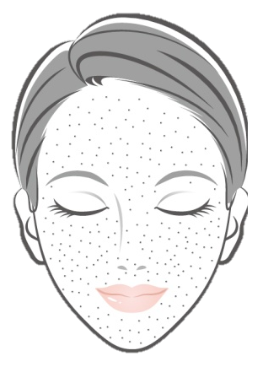
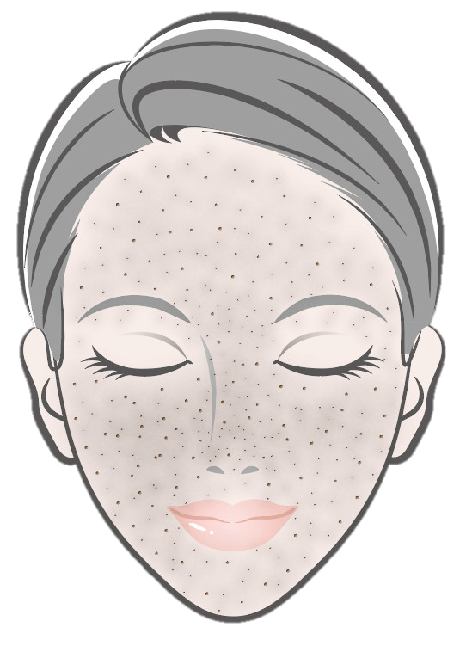
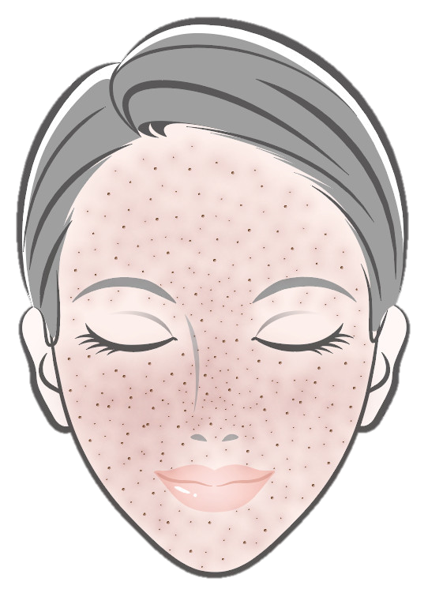
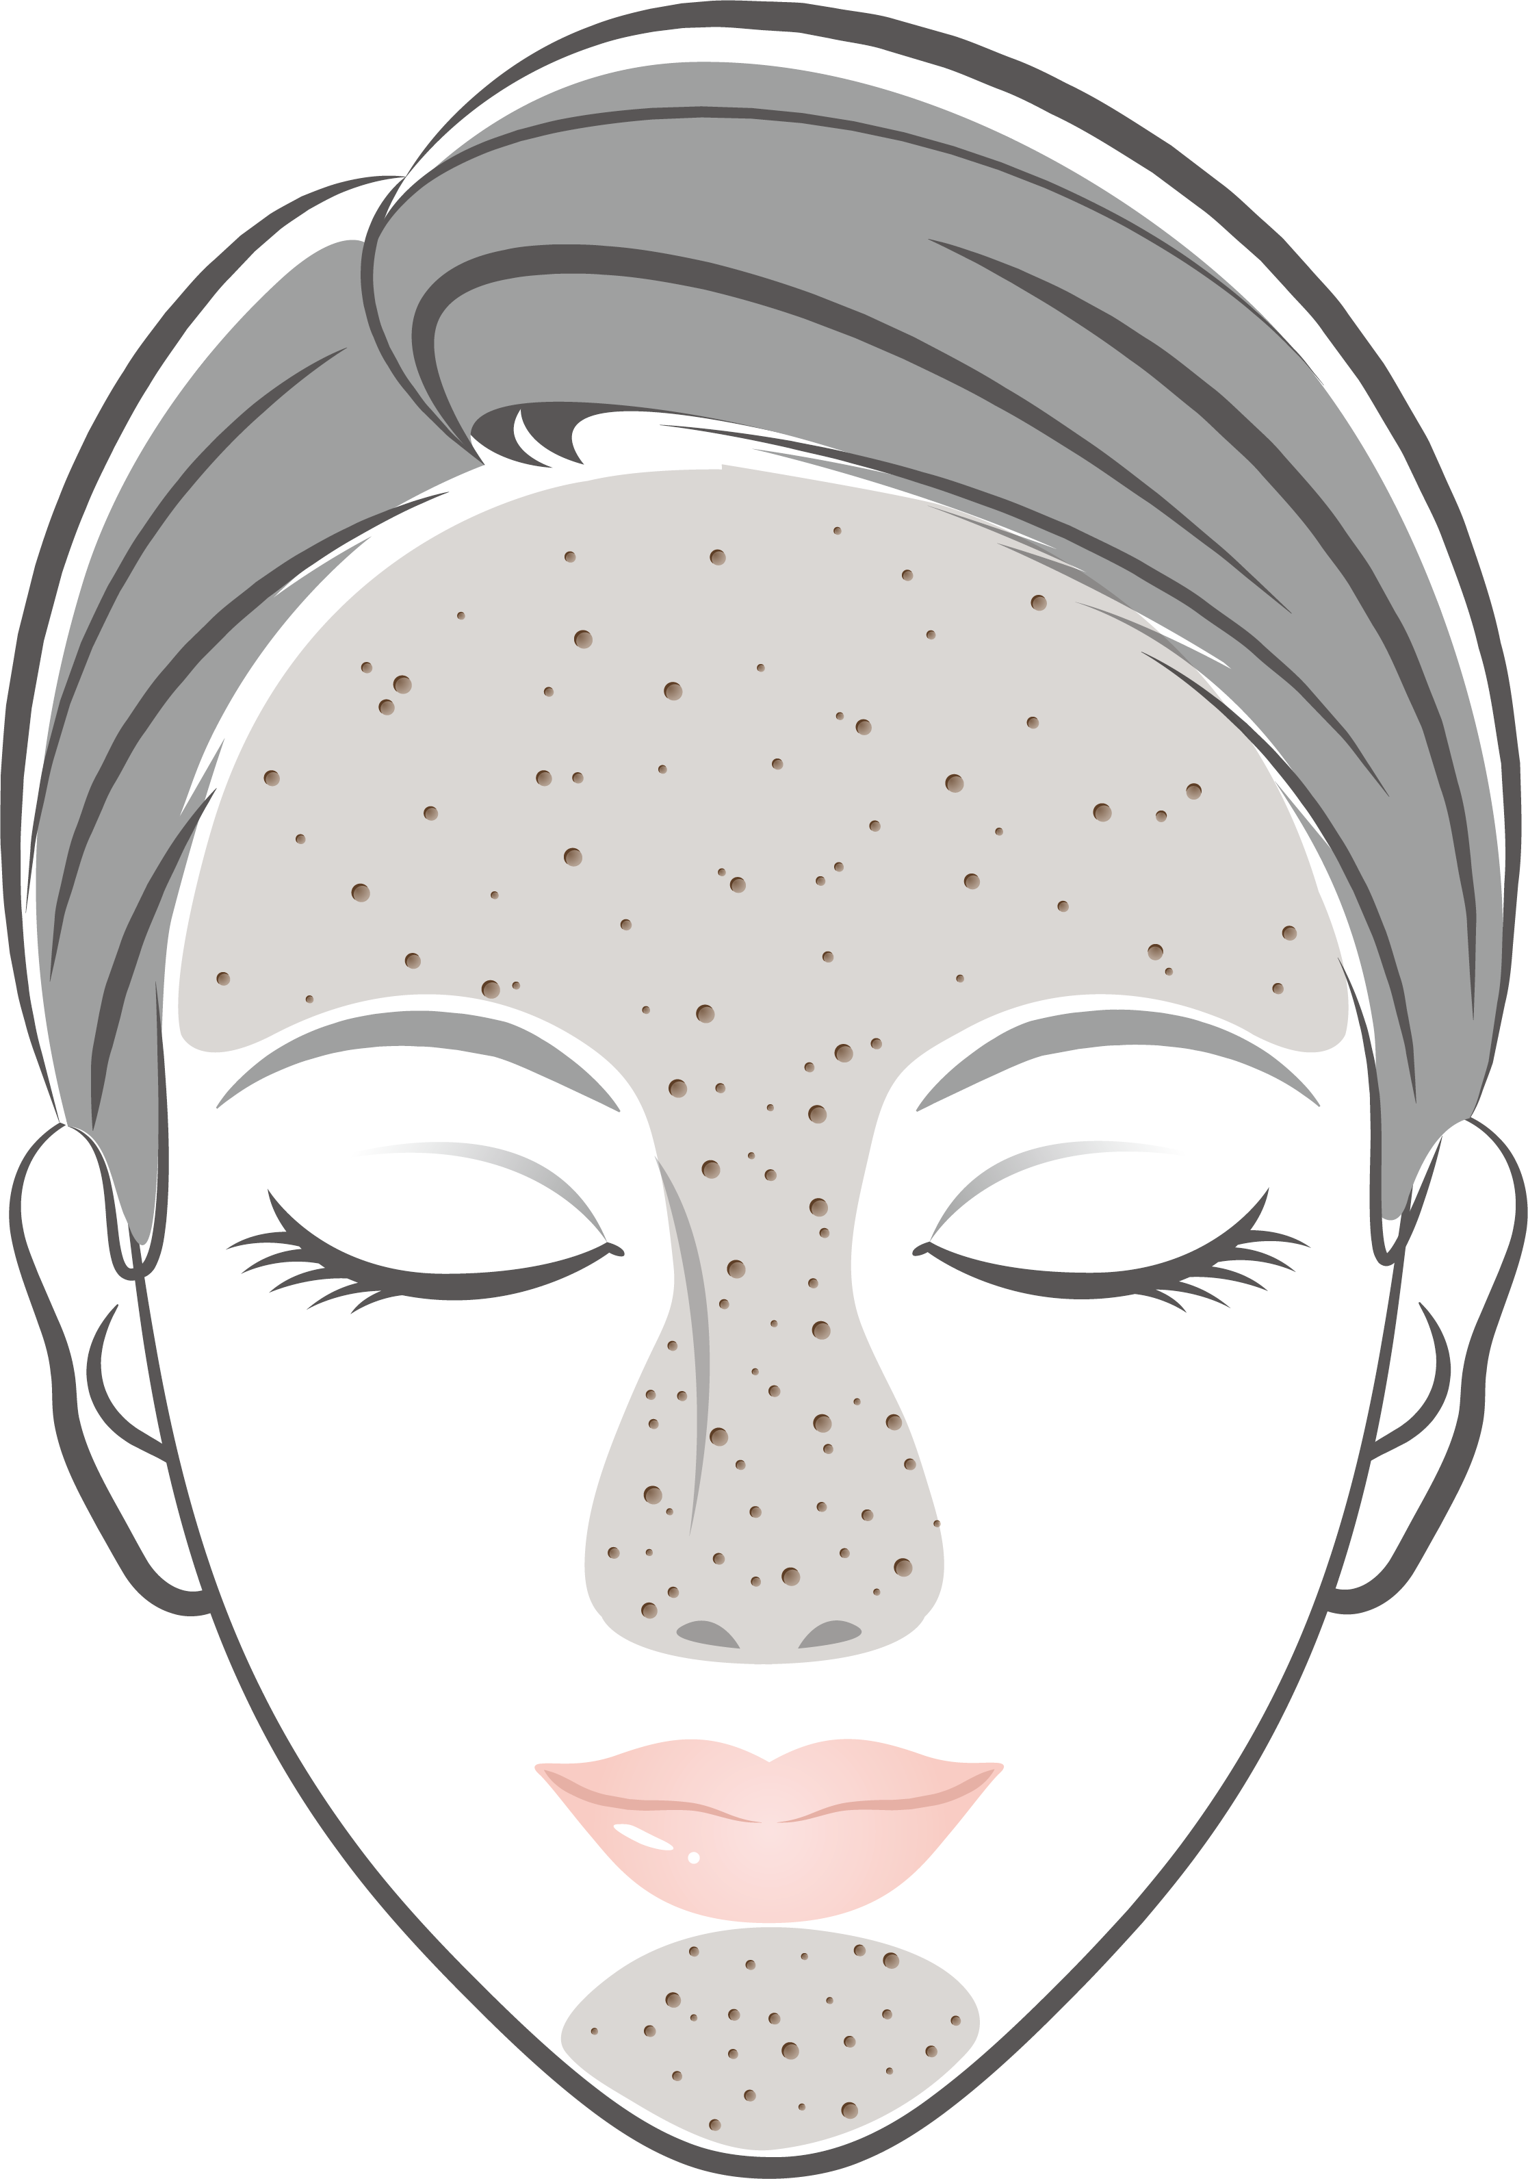
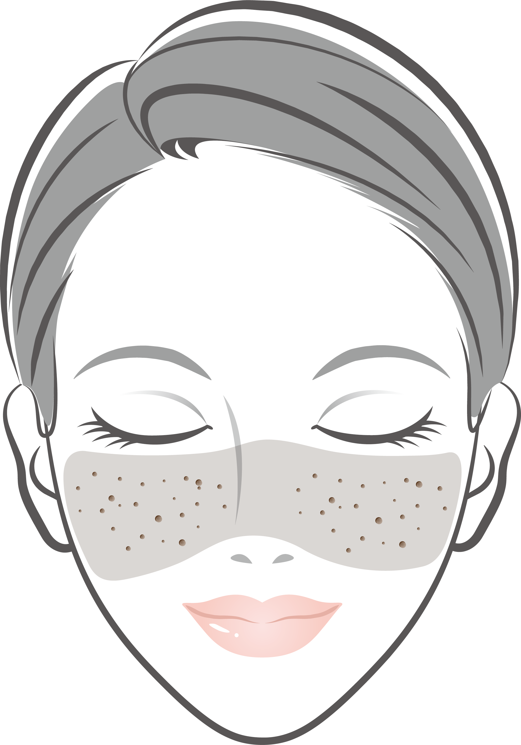
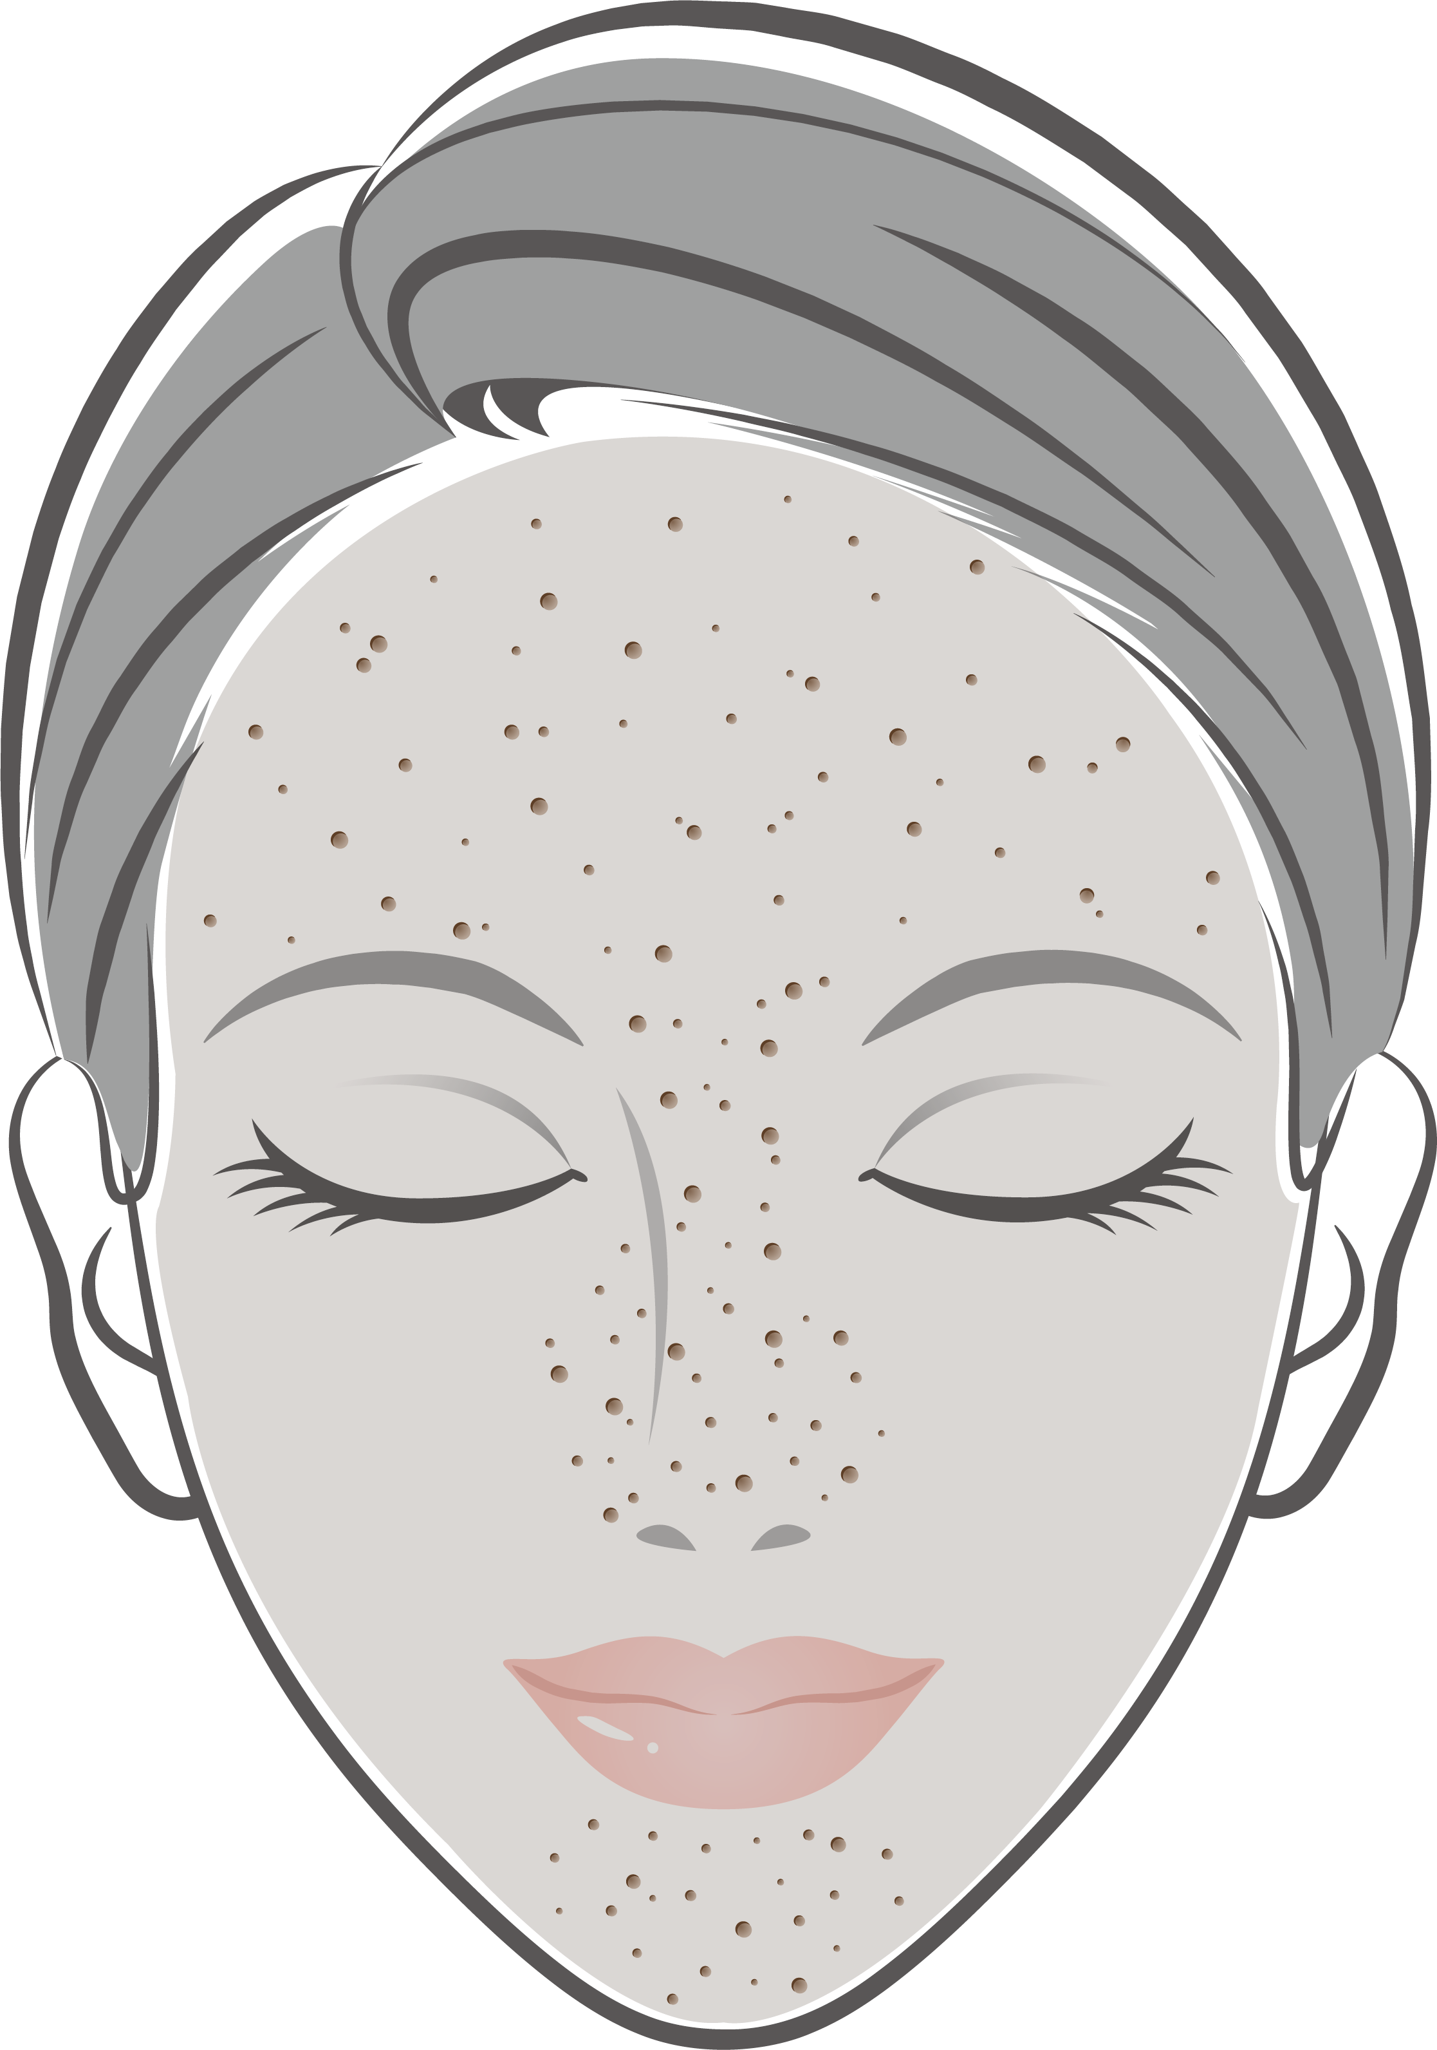
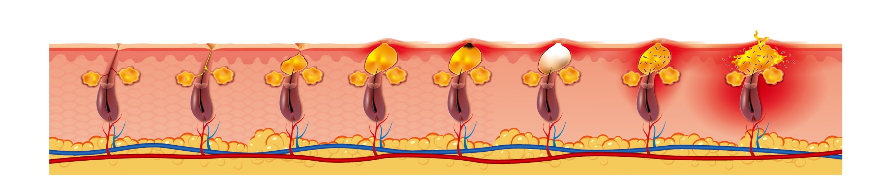
Treatment Guidelines
<Acne & Pore-related conditions>
Pore- related conditions | Enlarged pores | Seborrhea (Dark yellow) - Seborrheic dermatitis | Redness (Flushing) - Acne rosacea
Indication Progress | ① As the number of pores on the face and the pore size increases, sebum is secreted onto the skin surface and sebum builds up, concentrated areas of the face with high concentration of pores. | ② As more sebum is released from facial pores, the areas of skin with high concentration of pores will turn yellower. | ③ If the sebum on the facial pore areas accumulates over the longer term, the areas become sensitive and redness appears
Step 2. [Focused]
- Enlarged Pores
- Seborrheic dermatitis
- Acne rosacea
Treatment Steps
Step 1. [Full Face] UltraGlow Therapy
OR
[T-zone]
[Nasal-zone]
Step 2. [Focused] Active Acne
UltraGlow Therapy
Indications | Skin Type | Tip Type | Energy (mJ) | Mode | Passes | Coverage % | Total Energy(kJ) | Session | Interval (week)
Uneven skin tone Skin roughness Fine wrinkles (30 ~ 50 yrs) | I-III | C1 Roller | 10 ~ 15 | Random | 4 ~ 6 | 12 - 25 | 0.2 ~ 0.5 | 3 ~ 5 | 3 ~ 4
 | III-VI |  | 8 ~ 10 |  | 2 ~ 4 | 5 ~ 12
 | UltraGlow Therapy is a basic rejuvenation technique that improves the overall skin tone, texture and fine wrinkles together for total skin glow. For all facial area treatments, follow UltraGlow Therapy parameters for the full face first, and then target the following focal indications.
[FULL FACE]
[Focused]
Indications | Skin Type | Tip Type | Energy (mJ) | Mode | Passes | Coverage % | Session | Interval (week)
Step 2. Enlarged Pores Seborrheic dermatitis Acne rosacea | I-VI | C1 Roller | 10 ~ 15 | Static | 2 ~ 3 | 10 ~ 30 | 3 ~ 5 | 3 ~ 4
 | Perform multiple passes on target area (e.g. T-zone) to improve the enlarged pores, seborrhea and acne rosacea condition and assist with cooling to support comfort and shorter downtime.
or
Step 2. Active Acne (Acne vulgaris) | I-VI | C1 Roller | 15 | Static | 2 | 20 | 3 ~ 5 | 3 ~ 4
 | Perform multiple passes on individual active acne lesions and comedones to reduce inflammation and reconstruct the infundibulum. Recommend for the pustule, papule, nodule, cystic types of active inflammatory acne condition.
▪ End point: Moderate erythema and edema ▪ Post care: Moisturize the skin and apply cooling
▪ Note
► Apply anesthetic cream for 40 - 50 min.
► Microcrusts will form after the treatment and will naturally fall off within 3 - 7 days.
► Post-treatment, select and apply an effective ampoule is recommended according to the patient's skin condition.
3

Slide 4
Treatment Guidelines
<Scars>
Treatment Steps
Step 1. [Focused] Acne scars
Step 2. [Full Face] UltraGlow Therapy
Treat acne scars individually with high energy in static mode
Endpoint
: Moderate erythema and edema
Treat full face including acne scar areas with UltraGlow Therapy protocol in random mode
Endpoint
: Moderate erythema and edema
Acne scars
Indications | Skin Type | Tip Type | Energy (mJ) | Mode Density | Passes | Coverage % | Session | Interval (week)
Acne scars | ① I-VI | C1 Square | 15 ~ 20 | Static | 1 ~ 2 | 15 ~ 20 | 3 ~ 5 | 4
 | ② I-VI | C1 Roller | 10 ~ 15 | Random | 2 ~ 3 | 6 ~ 12 | 3 ~ 5 | 4
 | Apply 1st pass with static mode individually over the deep scars and deliver the 2nd pass in random mode over the full face including the areas affected by acne scars. When using Static Mode, perform treatment with horizontal and vertical overlapping. End point: Moderate erythema & edema Post care: Moisturize the skin and apply cooling
Step
Step
Other Scars
Indications | Skin Type | Tip Type | Energy (mJ) | Mode Density | Passes | Coverage % | Session | Interval (week)
Atrophic Scar Linear Scar Stretch Mark | I-VI | C1 Roller | 10 | Random Static | 3 ~ 4 | 10 ~ 12 | 3 ~ 5 | 4
 | Apply the treatment along the scar line or stretch mark lines. When using Static Mode, perform treatment with horizontal and vertical overlapping. End point : Moderate erythema & mild edema Post care : Moisturize the skin and apply cooling
or
<Bruising>
Bruises
Indications | Skin Type | Tip Type | Energy (mJ) | Mode Density | Passes | Coverage % | Session | Interval (week)
Bruises (Post Fillers, Thread Lift etc) | I-VI | C1 Roller | 10 | Random | 4 | 12 | 1 | -
 | Treatment should be performed soon after the bruise is observed (within 24 hrs) and before yellowing. End point : Moderate erythema & mild edema Post care : Moisturize the skin and apply cooling
4

Slide 5
Treatment Guidelines
<Pigmentation>
Melasma / PIH
Indications | Skin Type | Tip Type | Energy (mJ) | Mode Density | Passes | Coverage % | Session | Interval (week)
Melasma PIH | I-II | C1 Roller | 3 ~ 5 | Random | 2 ~ 4 | ~ 5 | 3 ~ 5 | 2
 | III-VI |  | 1 ~ 3 |  |  | ~ 2
 | End point: Mild erythema Post care: Moisturize the skin and apply cooling and TA ampoule Note ► Please avoid the melasma areas when treating the full face with UltraGlow Therapy parameters.
C5 Tip
Epidermal Pigment
Indications | Skin Type | Tip Type | Energy (mJ) | Mode Density | Passes | Coverage % | Session | Interval (week)
Solar lentigines Seborrheic keratosis Café-au-lait macules | I-II | C5 | 10 ~ 15 | Static 225 spots/cm2 | 2 ~ 3 | 20 ~ 30 | 3 ~ 4 | 4
 | III-VI |  | 5 ~ 10 |  | 1 ~ 2 | 8 ~ 12
 | Perform treatment with C5 over an area wider than the lesion. End point : Mild erythema and grey color change Post care : Cooling and apply hydrocortisone until microcrust flakes off Note ► If a thick microcrust forms, let it fall off naturally and do not forcibly remove it to avoid the potential for PIH.
Riehl’s Melanosis
Indications | Skin Type | Tip Type | Energy (mJ) | Mode Density | Passes | Coverage % | Session | Interval (week)
Riehl’s Melanosis | I-VI | C1 Roller | 8 ~ 10 | Random | 3 ~ 4 | 7 ~ 13 | 3 ~ | 3 ~ 4
 | Apply anesthetic cream for 30 - 40 min. Microcrusts will form after the treatment and will naturally fall off within 3 - 7 days. End point: Moderate erythema & edema Post care: Moisturize the skin and apply cooling
C5 Tip
Vulvar Hyperpigmentation
Indications | Skin Type | Tip Type | Energy (mJ) | Mode Density | Passes | Coverage % | Session | Interval (week)
Vulvar Hyperpigmentation | I-VI | C5 | 5 ~ 10 | Static 225 spots/cm2 | 1 ~ 2 | 12 ~ 20 | 3 ~ 5 | 4 ~ 5
 | Treat an area larger than that than limited only to the lesion area with C5 tip. End point: Mild to moderate erythema Post care: Apply moisturizer and bleaching cream or LaseMD TA ampoule for 1 month Note ► Please let any microcrusts fall off naturally and do not forcibly remove them to avoid the potential for PIH.
5

Slide 6
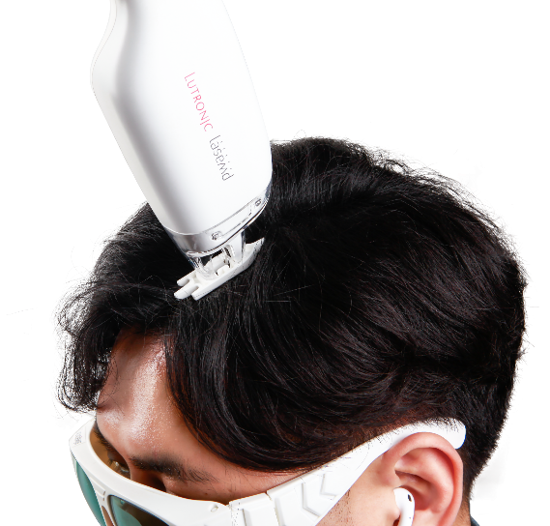
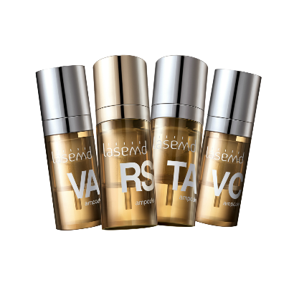
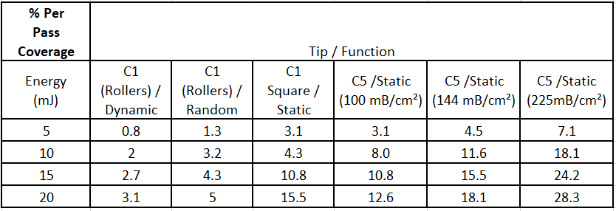
Treatment Guidelines
<Hair Regrowth/Scalp Revitalization>
Indications | Skin Type | Tip Type | Energy (mJ) | Mode Density | Passes | Coverage % | Session | Interval (week)
Hair loss in males & females Thin and low-density hair | - | C1 Comb | 3 | Static | 2 without overlap | 4 ~ 5 | 4 ~ 6 | 3 ~ 4
 | Treat the wider target area with a comb tip while parting hair line by line. No topical anesthesia required. Endpoint: Mild erythema on the scalp. Note ► Make sure that the scalp is dry and try to expose the scalp by parting the hairs as much as possible to avoid damage to the hair shaft. The application of topical solutions or appropriate medications is recommended. | No topical anesthesia required. Endpoint : Mild erythema on the scalp. Note : Make sure that the scalp is dry and try to expose the scalp by parting the hairs as much as possible to avoid damage to the hair shaft. The application of topical solutions or appropriate medications is recommended.
With Comb Tip
General Treatment Tips
• Observe < 15% coverage on dark skin type (> Skin type III) to avoid temporary darkening.
• Observe < 5% of coverage on melasma to avoid a rebound melasma flare.
• Apply anesthetic cream 30 min-1 hour before the treatment when energy is > 5 mJ.
• Apply an air cooler (e.g., a Zimmer) to improve patient comfort during procedure (optional).
• The results when treatment is combined with LaseMD Ampoules or skin booster are always better than the results with Ultra laser alone.
• Post care: Moisturize the skin and apply cooling (when energy is > 3 mJ)
Coverage is based upon surface area and measurement of the coagulation zone based on measurements taken from histological specimens.
6

Slide 7



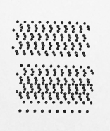

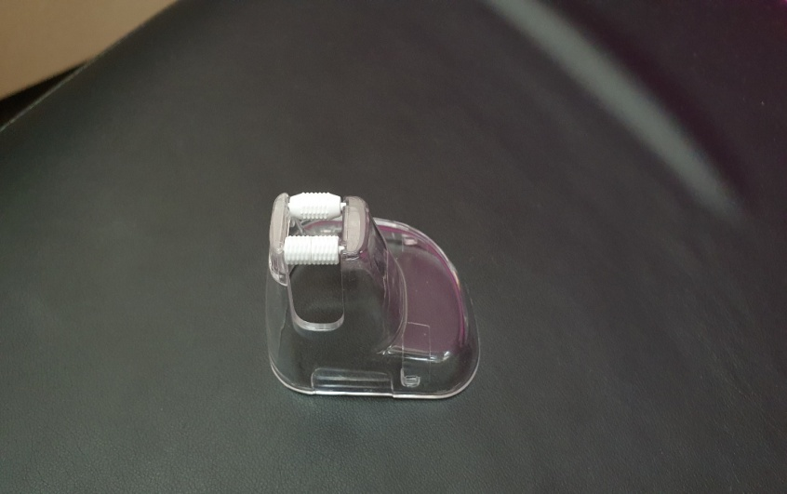
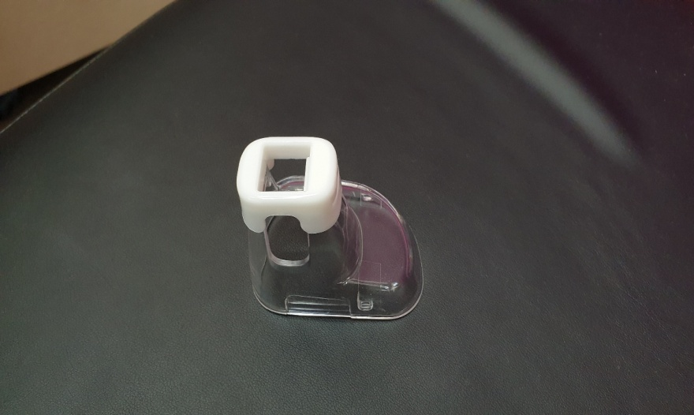
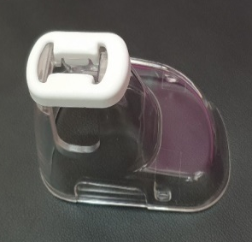
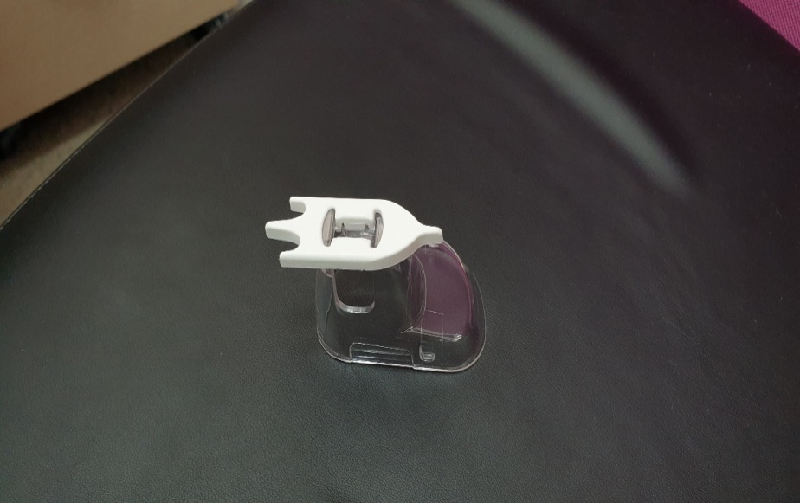
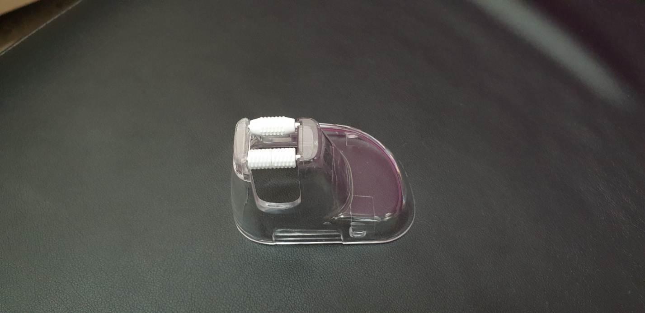
Operation Guidelines
Operation Mode
Mode | Dynamic | Random | Static | CW
Operating | Footswitch + Rolling | Footswitch + Rolling | Footswitch only (Interval can be set) | Footswitch only (Continuous shots)
Available Tips | Roller Only | Roller Only | Roller Square Tip Comb Tip C5 Tip | Roller Square Tip Comb Tip
Beam Pattern | Regular | Random (CCT) | Regular | Regular continuous
Density | 25 spots/cm² | 40 spots/cm² | C1 - 100 spots/cm² C5 - 100 spots/cm² 144 spots/cm² 225 spotss/cm² | N/A
▪ Operation Mode
Random mode is recommended for faster and more uniform treatment with a smaller number of passes for all indications, but it is more aggressive since it delivers a higher density than in Dynamic mode.
In Static mode, the user can adjust the interval (single, 0.5 s, 1.0 s and 2.0 s only) and Density Selection is available only with
the C5 tip in Static mode (100 spots/cm², 144 spots/cm² and 225 spots/cm²).
CW mode is specially designed for hair treatment, and laser energy will be delivered to the target continuously once you press the footswitch.
4 Types of Tip
 | Roller Tip | C5 Tip | Square Tip | Comb Tip
Tips
Treatment Area | Face Off Face/ Body | Face Off Face/ Body | Face Off Face/ Body | Hair Regrowth
Operation Mode | Dynamic/ Static Random/ CW | Static only | Static/ CW | Static/ CW
How to assemble the rollers
Pull ⓑ first and gently remove the whole roller.
Match and insert ⓐ and ⓑ in that order.
The rollers should be assembled in pairs.
ⓐ
ⓑ
Roller without a groove
Magnetic roller with a groove in the center

Slide 8
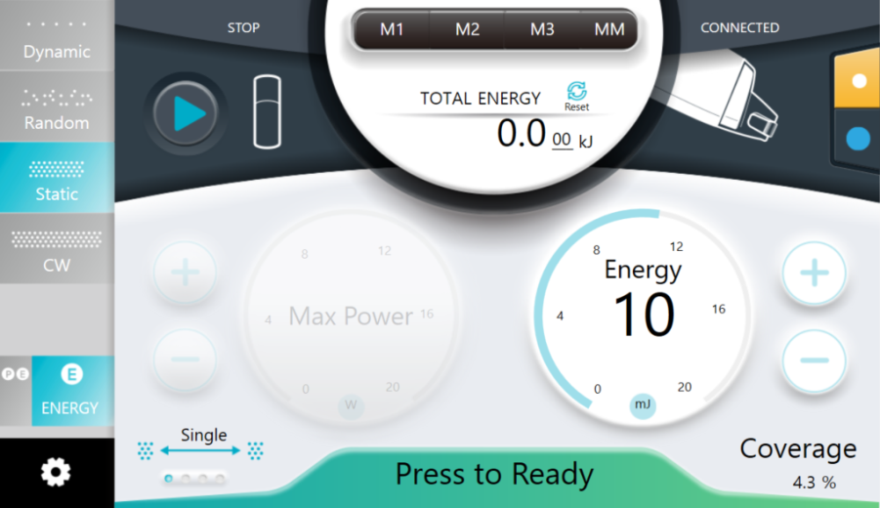


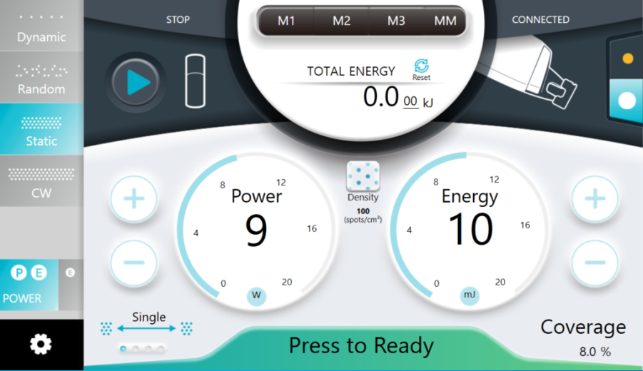
Operation Guidelines
GUI (Graphic User Interface)
ENERGY mode
Oscillator power button
This button turns the oscillator ON/OFF
Memory button
The user can record the parameter wanted
Select operation modes
Dynamic, Random,
Static, CW
Select the Tip type
C1 type: microbeam
size 200 µm
C5 type: microbeam
size 350 µm
Mode change
The user can select the
Mode (Power/ Energy)
Adjust ENERGY (mJ)
The user can adjust the
energy by using the
+/- buttons or dragging
to the value on the
screen dial (1~20 mJ)
Interval button
The user can adjust the time
interval between shots (single, 0.5 s,
1.0 s and 2.0 s only in Static mode)
Ready button
Toggles between READY and STANDBY modes
Coverage(%) display
The user can check the coverage on each
Pattern type and the Parameter the user
has selected
POWER mode
Adjust POWER (W)
In POWER mode, the user
Can adjust the Power by
using the +/- buttons or
dragging to the desired
value on the screen dial
(5 ~ 20 W).
Adjust DENSITY
(only with the C5 tip)
The user can adjust the Density in the Static mode
100 spots/cm²
144 spots/cm²
225 spots/cm²
When the ‘READY’ button is pressed, the system will be in the READY mode, and laser energy will be emitted when the footswitch is depressed.
Once the oscillator power button is pressed, the device automatically mixes the ampoule contents for 6 minutes.

Slide 9

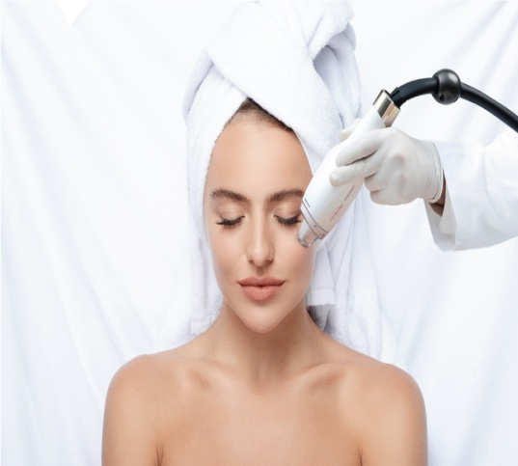
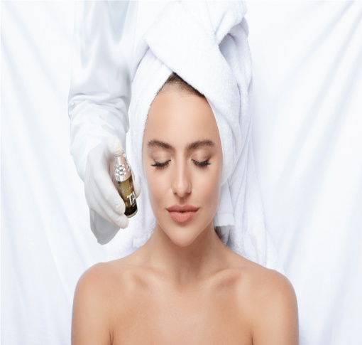
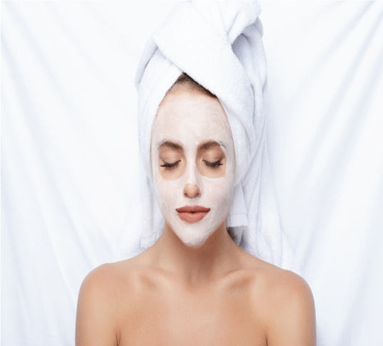
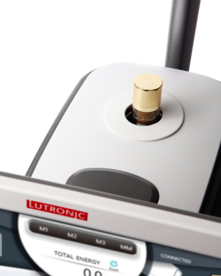
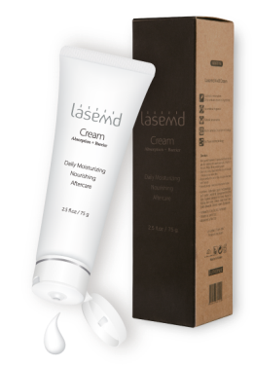
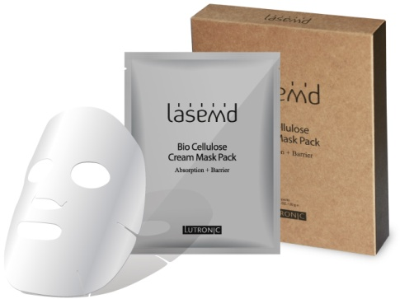
Clinical Guidelines
LaseMD Cosmeceuticals
Step 1
Step 2
Step 3
1. Please keep the ampoule in a cool and dry place and keep out of direct sunlight. Storage in a refrigerator under 5°C is recommended but do not freeze the ampoule.
2. Before sleeping, wash the face well with warm water, shake the ampoule well. Apply 0.5 ml of the serum (around 2 pumps) on the face or skin.
3. Toner, cream or lotion can be applied after the LaseMD ampoule.
4. Start applying the ampoule periorbitally and work towards the periphery of the face.
5. To maintain the moisturizing effect with an occlusive dressing, use a LaseMD cream or LaseMD cream mask pack after applying the ampoule.
6. The contents of the LaseMD ampoule will remain active for 2 weeks, so it is recommended to visit the clinic after 2 weeks even if the contents of the ampoule look OK.
7. When any change in the color of the ampoule contents is noted after 2 weeks, do not use the ampoule and discard it.
8. Some powder may be visible in the solution in the ampoule. In that case, shake the ampoule well before use to dissolve the powder.
LaseMD Ampoules
LaseMD Cream
LaseMD Mask pack
For more information, please contact your distributor.

Slide 10
Clinical Guidelines
Contraindications
Contraindications
Pay special attention and take precautions when treating patients with the following symptoms or conditions.
Allergic response to topical anesthetics, antibiotics or other medications
Pregnancy and/or nursing
Current skin cancer or other condition of any type of cancer or premalignant moles
Impaired immune system due to immunosuppressive diseases such as AIDS and HIV, or use of immunosuppressive medications
History of bleeding disorders or use of anticoagulants
Medications: Daily anticoagulation therapy, iron supplements, herbal supplements such as ginko, ginseng, garlic, tetracyclines or St. John’s Wort within the 2 weeks prior to treatment.
Medications that induce photosensitivity. Stop the medication if possible for 3-5 days prior to treatment.
History of diseases stimulated by heat, such as herpes simplex virus (HSV) 1 and 2: Do not treat if any active lesions are present within the intended treatment area. Patients with a known history of frequent HSV 1 and 2 lesions should begin prophylaxis prior to treatment as prescribed by their physician.
Individuals with poorly controlled medical conditions should be evaluated by their physicians for medical clearance.
Active skin conditions or infection in the treatment area such as sores, psoriasis, eczema and rash: Avoid treatment of open wounds and skin that is actively infected.
History of skin disorders, keloid scarring, abnormal wound healing: These should be screened for by thorough history taking.
Any Botulism toxin applied to the treatment area within 2 weeks or natural fillers applied to the treatment area within 4-6 weeks prior to treatment.

Slide 11
Clinical Guidelines
Pre- and Post Treatment
Pre-treatment Notes
Advise the patient in the weeks prior to the procedure to avoid skin irritation or tanning, and to discontinue any irritant topical agent.
The patient should arrive for treatment with clean skin. No lotion, make-up, perfume, powder, bath/shower oil should be present on the area to be treated.
Apply topical anesthetics, if needed.
Use dental rolls, gauze, or a tongue depressor to isolate areas from underlying dental appliances or implants to make the treatment more comfortable.
Post-treatment Notes
Patients may experience a burning sensation for 1-2 hours immediately after the treatment. Cooling with an ice pack can provide relief to the treated area. Make sure to enclose the ice pack in sterile and dry gauze to prevent water from penetrating the tissue in the treated area.
Keep the treatment area moisturized. After the first day, gently wash and pat the skin dry for two days. Do not scrub the treated area. Moisturize daily. Usually, any crust will fall off naturally within 5-7 days after the treatment. Do not be tempted to remove it forcibly.
Please do not use cosmetics which contain active ingredients such as Retinol or AHA after treatment without prior permission from the doctor.
Avoid exercising for the first week post-treatment or until initial healing has occurred. Increased redness may result from any activity that increases blood flow or body temperature (e.g., alcohol consumption, exercise, and sauna).
Avoid using cosmetics containing alcohol for at least 1 week after treatment.
For at least 20 days after treatment, apply a UV A/B sunblock daily with an SPF of at least 50 and PA+++. Use an umbrella, hat or any other available protection against sunlight while spending time outdoors.
Please contact your doctor with any questions or concerns.

Slide 12

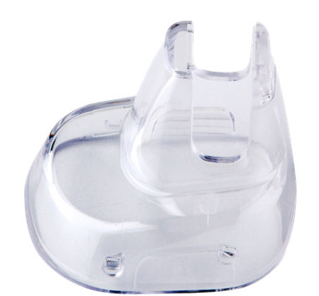

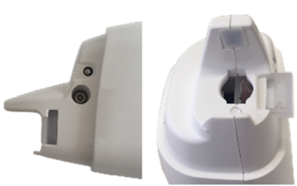
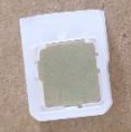
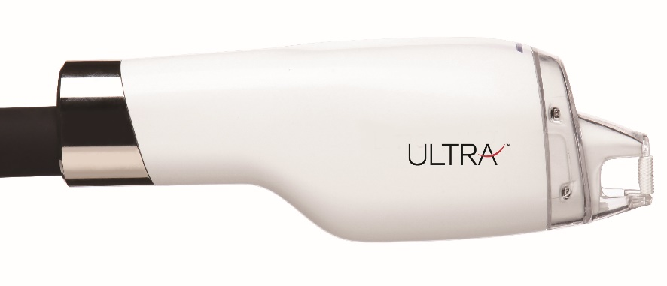
Maintenance Guidelines
Cleaning the System Main Body
Soak a soft pad in a non-corrosive cleansing liquid such as Isopropyl alcohol or ethanol 70% or higher and gently wipe the surface areas of the device.
Wipe down the device again with a clean, dry pad, or let it naturally air dry.
CAUTION: Do not apply cleansing liquid directly to the system main body as it may damage, harm or cause the system to malfunction.
Cleaning the Handpiece & Attachments
Handpiece
Tip
Lens
Cap
Tip
Cap
Handpiece
The handpiece, cap, tips and lens should be kept clean at all times. The following cleaning procedure should be observed after first cleaning your hands.
Hold the body of the handpiece with one hand, and with the other hand gently pull out the handpiece tip to separate it from the main body.
Using a soft, lint-free dry cloth soaked in 70% alcohol, gently wipe the entire area of the handpiece and handpiece cap.
To remove all dust and debris from any area, use a cotton swab soaked in 70% alcohol to clean the area thoroughly.
With the handpiece cap removed, remove the lens from the handpiece as shown in the picture above.
Wipe both sides of the lens to remove any visible debris using an alcohol-soaked gauze (at least 90%) and let it air dry.
Replace the lens into the slot and reassemble the handpiece by gently pushing the handpiece cap back onto the end of the handpiece body.
When not using the handpiece, store it in the handpiece case.
CAUTION: The handpiece, cap, tips and lens must be cleaned thoroughly with alcohol prior to use. A dirty lens can cause a loss of energy and produce less effective results during treatment. Incurred damages as a result of failure to perform this routine maintenance will void the warranty. Lutronic Corporation will not be held liable for any side effects or accidents that occur if rollers, square tips, comb tips or C5 tips are reused.

Slide 13

Maintenance Guidelines
Status Messages (Error Codes)
Condition code | Possible Reasons for Abnormal Actions | Actions to Take
CODE 01 | Emergency stop switch has been pressed. | Turn off the device and reset the emergency switch. Restart the device.
CODE 04 | Interlock switch is unconnected. | Turn off the device, and check if the interlock switch is properly connected, then wait 2 min before restarting the device.
CODE 06 | Handpiece cap Error | Check the connection of the handpiece cap. Restart the device.
CODE 02, 03, CODE 07~22 |  | Contact your local Lutronic distributor/ Service representative for inspection.
When an error occurs, LEDs on the Energy bar displaying a number from 1-20 will light up. Each number represents the error code of the abnormal action that has occurred.
The operator is advised to take the recommended actions for each message code. If the error persists after the recommended proper action, contact your authorized Lutronic Service team for assistance. If a person not formally authorized by Lutronic opens the cover of the device or takes any improper actions, the warranty will be voided. Fatal damage to the device and/or severe physical injury may occur.
Notes:
532 nm heating

